Slide 1
Prototyping
Final version
WARNING
RP-008341-DS-1-raspberry-pi-4-datasheet.pdf

Slide 2
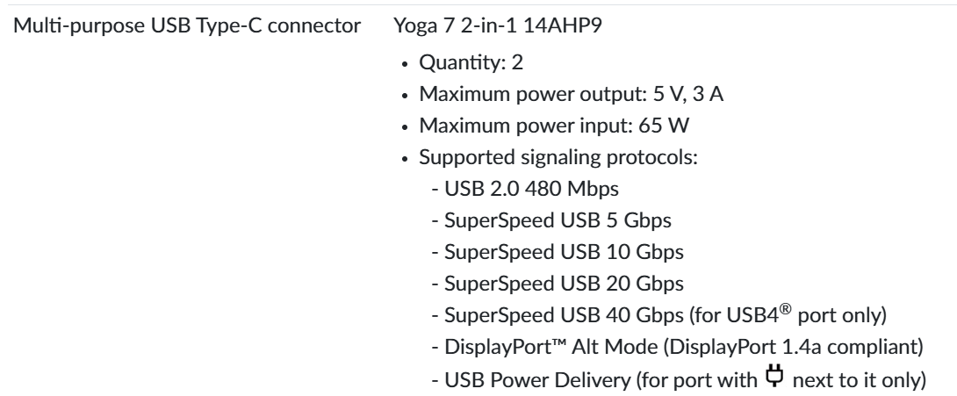
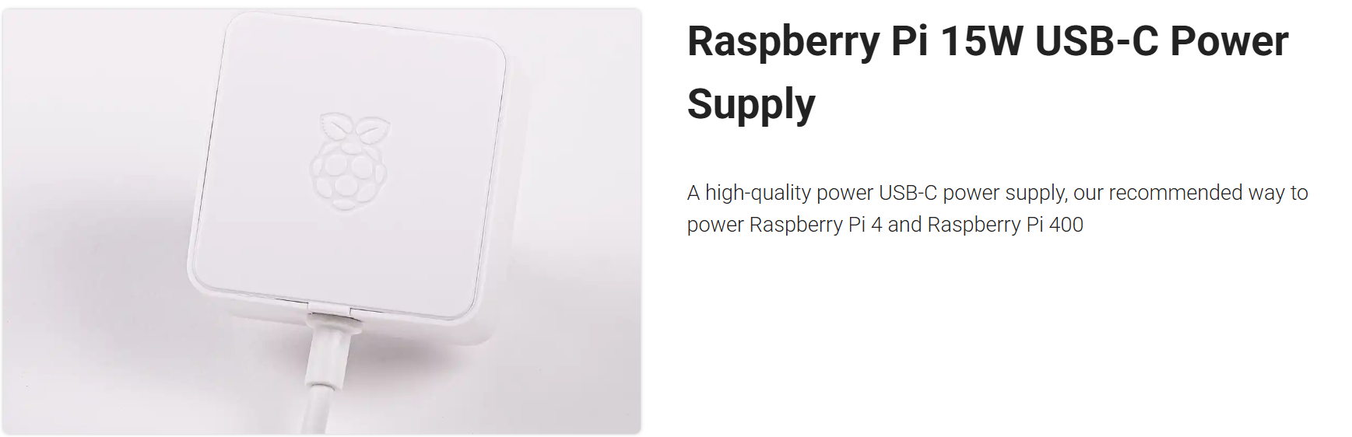
Need a USB-C cable for power only.
Optional

Slide 3
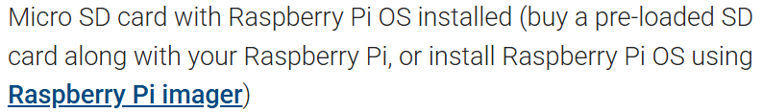
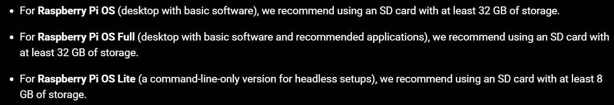
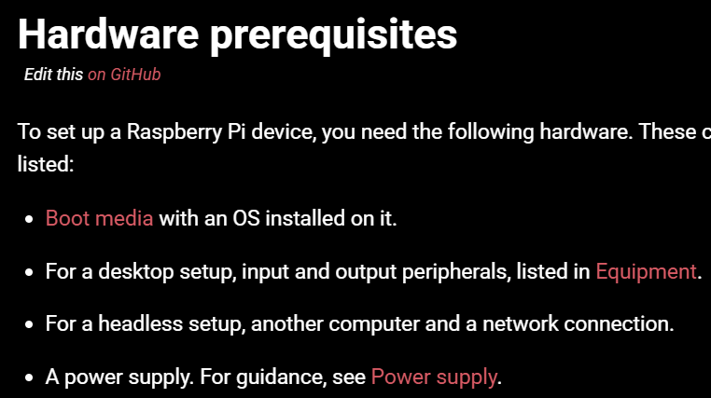
If we did not purchase the pre-loaded SD card, we will have to follow these steps.
If you want to work on this, you need a Micro SD card port on your laptop.
WARNING

Slide 4
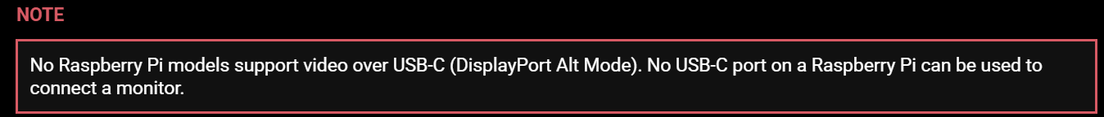
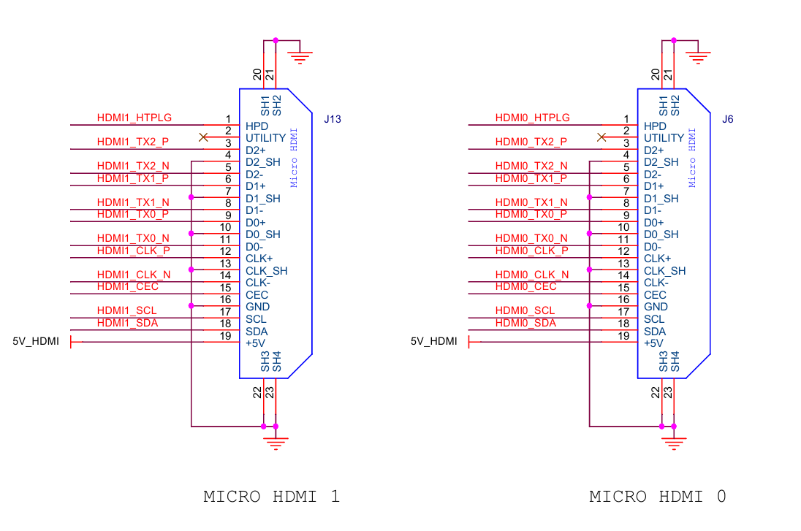
Need to purchase or get a micro-HDMI to HDMI/USB cable/converter/adapter to display live camera feedon Windows PC Monitor from Rasberry Pi.
The HDMI port on most laptops is output-only.

Slide 5
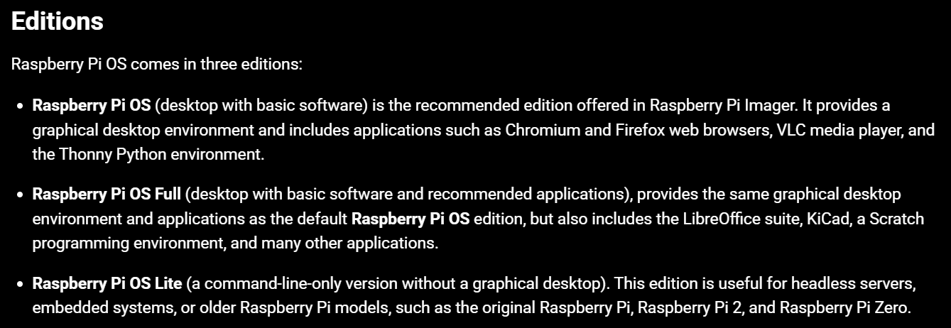
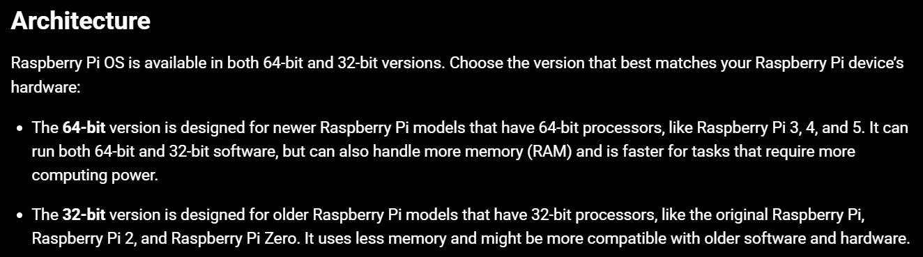
For independent subsystem prototyping and testing.
Final version with no graphics.

Slide 6
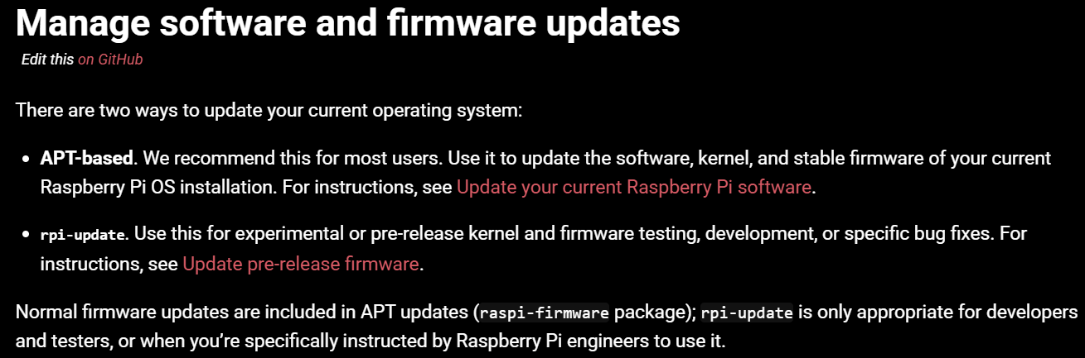
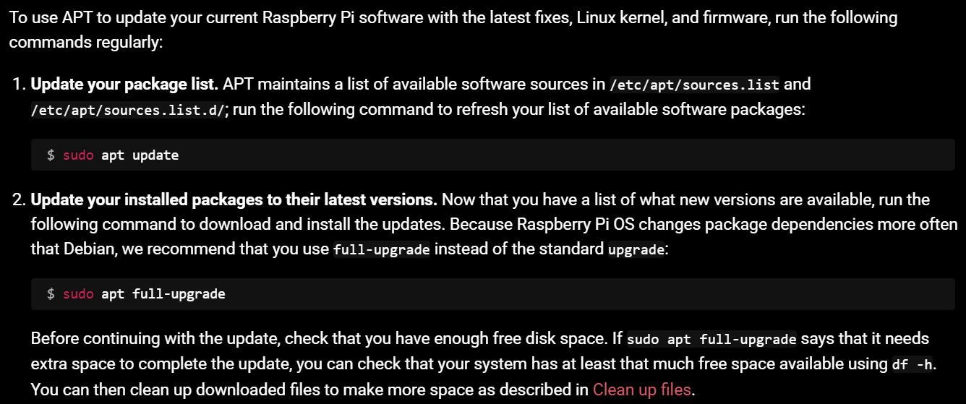
How to keep firmware updated.

Slide 7
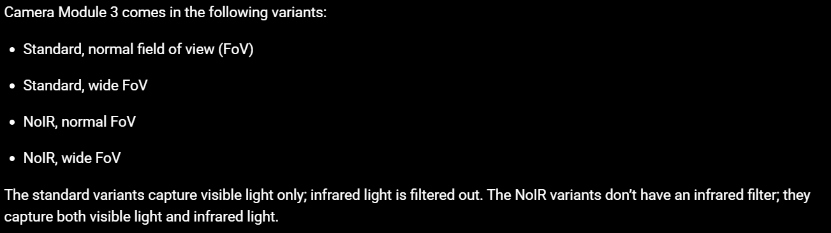
Setting up Camera
Datasheet
Getting started with the Camera Module | Python | Coding projects for kids and teens

